Slide 1
Comparative Technical Analysis of Image Processing and Computer Vision
Batch-04 TECHNICAL PRESENTATION
Presented by:
A.Shiva Shankar Reddy(192425174)
Jeswanth Kumar S (192321056)
K.Mounith(192425090)
Pavan Jana(192472313)
Raghavendra(192421354)
Guided by:
Dr.Carmel Mery Belinda
SIMATS ENGINEERING

Slide 2
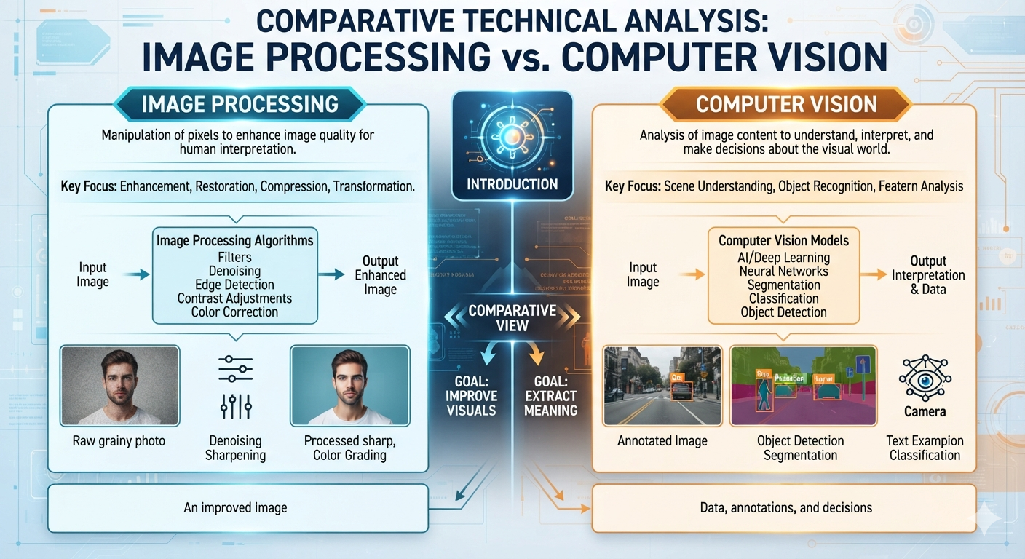
Introduction
Focuses on improving or modifying digital images.
Performs operations such as filtering, enhancement, restoration, and compression.
Produces an improved version of the original image.
Enables computers to understand the interpret images or videos.
Uses Artificial Intelligence and Deep Learning to recognize objects and make decisions.
Produces meaningful information rather than just an enhanced image.

Slide 3
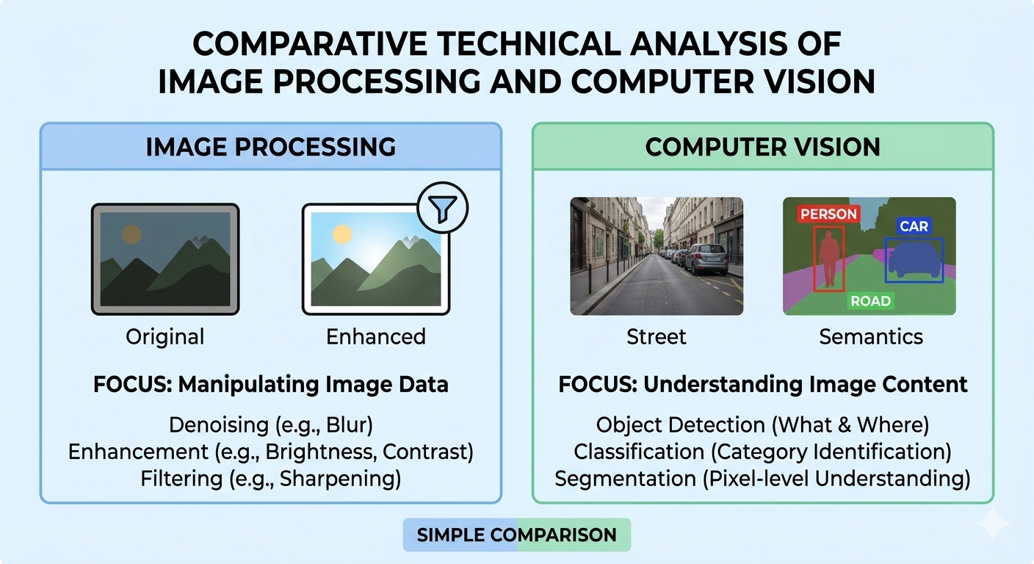
Objectives
To understand the concept of Image Processing.
To compare both technologies based on their scope and functionality.
To analyze techniques and algorithms used in each domain.
To study real-world applications.
To identify advantages and limitations.
To understand how Image Processing supports Computer Vision.

Slide 4
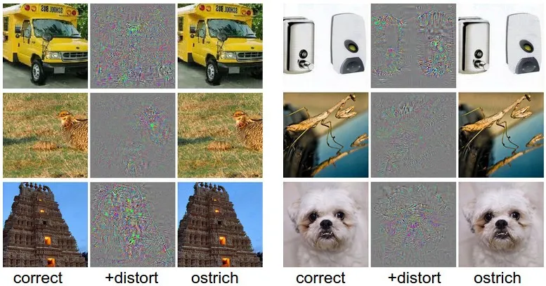
Problem Statement
Modern applications such as healthcare, autonomous vehicles, surveillance, robotics, and industrial automation require computers to process and interpret visual information accurately.
However, many people confuse Image Processing with Computer Vision, even though they solve different problems.
This study aims to compare both domains by analyzing their objectives, workflows, techniques, outputs, applications, advantages, and limitations to clearly understand their roles in intelligent visual systems.

Slide 5
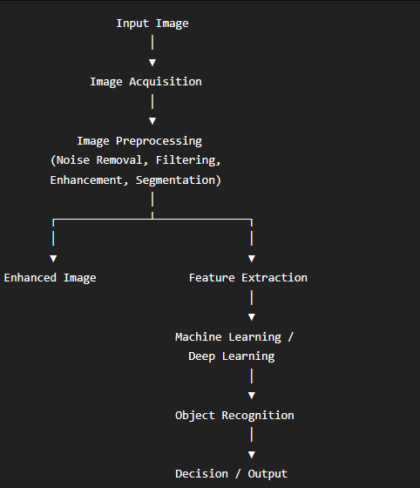
Architecture Diagram

Slide 6
Techniques & Algorithms
Image Processing Techniques
Image Filtering
Histogram Equalization
Edge Detection
Thresholding
Segmentation
Morphological Operations
Algorithms
Gaussian Filter
Median Filter
Sobel Operator
Canny Edge Detector
Computer Vision Techniques
Image Classification
Object Detection
Object Tracking
Face Recognition
Semantic Segmentation
Algorithms
CNN
YOLO
Faster R-CNN
SSD
ResNet
Vision Transformer (ViT)

Slide 7
Applications
Applications of Computer Vision
Self-driving Cars
Face Recognition Systems
Smart Surveillance
Robotics
OCR (Text Recognition)
Medical Diagnosis
Industrial Automation
Applications of Image Processing
Medical Image Enhancement
Satellite Image Processing
Photo Editing
Image Compression
Fingerprint Recognition
Document Scanning

Slide 8
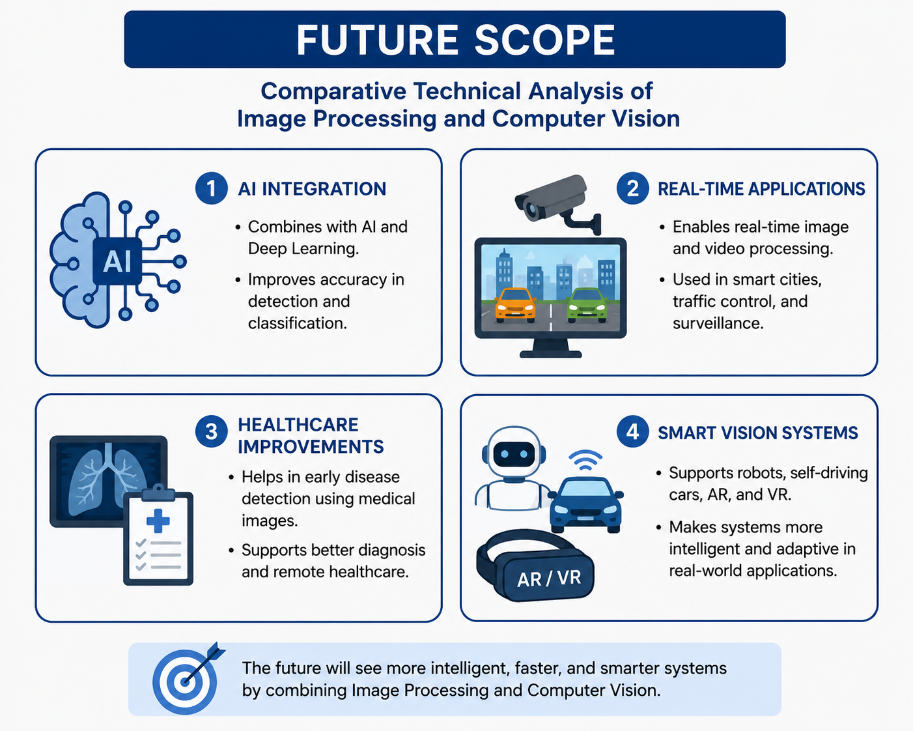
FUTURE SCOPE
AI Integration
Improve accuracy using AI and Deep Learning.
Real-Time Applications
Used in smart cities, traffic control, and surveillance.
Healthcare Improvements
Better disease detection using medical images.
Smart Vision Systems
Support robots, self-driving cars, AR, and VR.

Slide 9
Conclusion
Image Processing enhances and transforms digital images using filtering, segmentation, restoration, and enhancement techniques.
Computer Vision uses Artificial Intelligence and Deep Learning to analyze images, recognize objects, and make intelligent decisions.
Both technologies complement each other in modern applications such as healthcare, autonomous vehicles, security, robotics, and industrial automation.
Understanding the differences between these domains helps in selecting the appropriate technology for solving real-world visual computing problems.

Slide 10


